Slide 1
Measurement of Accommodation:
Amplitude, Facility,
Relative Accommodation, Fatigue, Lag,
Dynamic Retinoscopy
Bikash Sapkota
Optometrist
Maharajgunj Medical Campus (IOM), Nepal
Health Kura
Only for offline informational uses. Copyright © bikash Sapkota.

Slide 2
Presentation Layout
Introduction
Measurement of Accommodation
- Amplitude
- Facility
- Relative Accommodation
- Lag
Dynamic Retinoscopy

Slide 3
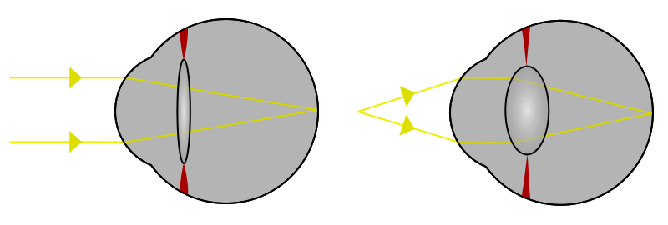
Accommodation
Dioptric adjustment of the crystalline lens of the eye
- to obtain clear vision for a given target of regard
Process by which the refractive power of eye is altered
- to ensure a clear retinal image

Slide 4
In an emmetropic eye
- parallel rays of light coming from infinity are brought to
focus on retina being accommodation at rest
- eyes can also focus diverging rays coming from near
object on retina to see clearly due to ACCOMMODATION

Slide 5
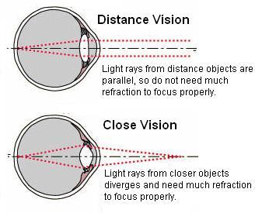

Slide 6
Mechanism of Accommodation
Ciliary muscle contracts
Ciliary ring shortens
Equator of lens move forward
As a result
Zonules are relaxed
Tension in capsule is relieved
Lens becomes spherical i.e. convexity increases
Increase in
dioptric power
Allowing near object to be
focused clearly on retina
Notes:
1. Helholth theory of relaxation…..Gulstrand mechanical model
2. Theory of increased tension( Tscherning theory)
3. Schachar’s theory
4. Cotenary ( hydraulic suspension) theory

Slide 7
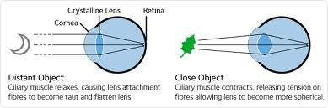

Slide 8
With Age
lens fibers & lens capsule lose elasticity
the size & shape of the lens increase
reduction of accommodative amplitude
onset of presbyopia

Slide 9
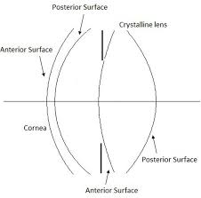
Ocular changes during Accommodation
Anterior r =11 mm
Posterior r = 6 mm
T = 4 mm

Slide 10
Ocular changes in Accommodation
Slackening of zonules – due to contraction of
ciliary muscles
Change in curvature of lens
- almost no change in posterior surface (6 mm)
- anterior surface radius of curvature
(from 11 mm to 6 mm)

Slide 11
Anterior pole along with iris moves forward
- shallowing of anterior chamber in centre
Pupillary constriction and convergence of eyes
- near triad
Choroid moves forward
Ora serrata moves by 0.05mm forward with each
diopter of accommodation

Slide 12
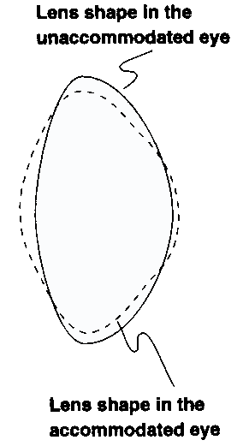
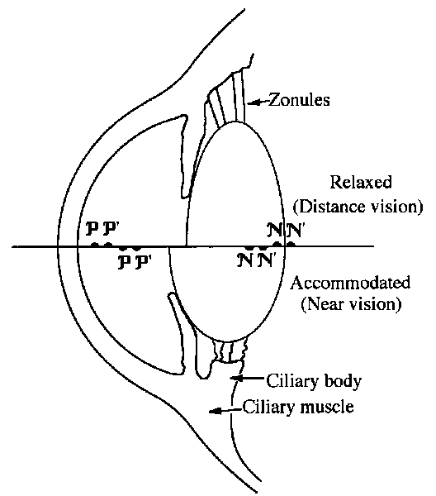
Lens shape change with Accommodation
Anterior r =6 mm

Slide 13
What triggers Accommodation ??
Image blur
Apparent size and distance of object
Disparate retinal images
Contrast
Luminance
Chromatic aberration

Slide 14
Components of Accommodation
Components
Tonic
Proximal
Vergence
Reflex

Slide 15
Reflex Accommodation
The normal involuntary response to blur which maintains a clear image
Largest and most important component
Automatic adjustment of refractive state to obtain clear retinal image
Occurs for small amount of blur, upto 2.00 D, beyond which voluntary effort is required
Voluntary Accommodation

Slide 16
Vergence Accommodation
Induced due to action of disparity (fusional) vergence
Gives rise to convergence accommodation/ convergence ratio(CA/C) =0.4 D per meter angle in young
Second major component of accommodation

Slide 17
Proximal Accommodation
Due to influence or knowledge of apparent nearness of object
Stimulated by targets located within 3m of the individual
Tertiary component of accommodation

Slide 18
Tonic Accommodation
Revealed in absence of blur, disparity, and proximal inputs as well as any voluntary or learned unusual aspects
Reflects baseline neural innervation from the midbrain
In young adults, ranges from 0 to 2 D
Notes:
Afferent: retina to striate cortex, parastriatr cortex,internuncial fibre to pontine nucleus to edinger westphal nucleus
Efferent: 3rd nerve, accessory ganglion, ciliary ganglion,reach sphincter pupillae and ciliary muscle

Slide 19
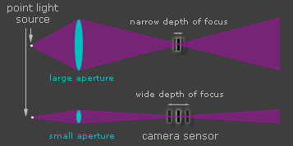
Depth of Field and Depth of Focus
When an object is accurately focused monocularly, often the objects somewhat near and somewhat farther away are also seen clearly without any change in accommodation
This range of distance from the eye is depth of field
The range at the retina in which an optical image may move without impairment of clarity is depth of focus
Notes:
Definition: The range of object distances for which the circles of confusion are so small that the image is sharp enough to be considered 'in focus' is called the depth of field.
Definition:The range of image distances over which the image of an improperly focused object is acceptably sharp is called the depth of focus.
Definition: The circle of confusion is the area of the retina over which the cells are stimulated by light from a point on an object. The bigger tthe circle, the more blurred the point becomes. The maximum acceptable circle of confusion determines the depth of field and focus of an eye.
Decreasing the pupil size: increases both the depth of field and the depth of focus.

Slide 20
Measurement of Accommodation
A full clinical examination includes assessment of accommodative function in five parameters
    Amplitude of accommodation
    Lag of accommodation
    Accommodative facility
    Relative accommodation
    Accommodation fatigue

Slide 21
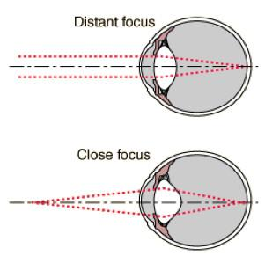
Amplitude of Accommodation
Punctum Remotum
- The farthest point at which the objects can be seen
clearly
- Infinity for emmetropic eyes
Punctum Proximum
- The nearest point at which objects can be seen clearly

Slide 22
Amplitude of Accommodation
Range of accommodation
- Distance between near point and far point
Amplitude of accommodation
- The dioptric difference between near point and far
point
(A= P-R)
Notes:
The dioptric difference between the punctum proximum and the punctum remotum is accomodative amplitude
The maximum amount by which the eye can change its power

Slide 23
Measurement of Amplitude of Accommodation
Push up method
Minus lens method
Notes:
Accommodation can be stimulated either by moving a test object closer to the eyes or by placing minus lenses in front of the eyes

Slide 24
Measurement of Amplitude of Accommodation
Push Up Method
- To determine maximum amount of accommodation that
eyes are capable of producing individually or together
- Done by RAF Rule, Livingstone Binocular Gauge,
Prince Rule
Notes:
Donder's push up method

Slide 25
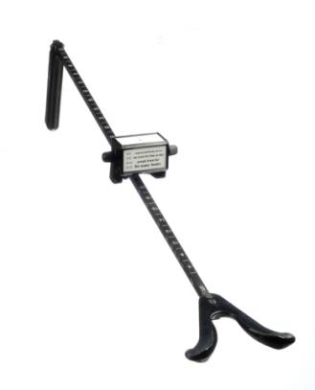
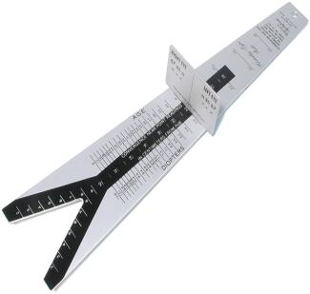
Royal air force rule
Metal rod
Test chart
Wing like support that fits over nose and rests against lower orbital margins
Prince Rule
1st side : divided into cm for NPA
2nd side : divided into diopter(NPA in D)
3rd side : age

Slide 26
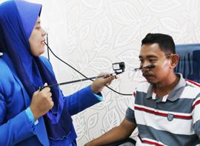
Procedure
Near visual acuity chart placed on near point rod
Direct patient’s attention to 20/20 line of letters on near point card
Patient left eye occluded
Notes:
The card should be illuminated by 40 watt incandescent bulb..excessive illumination will greatly increase the depth of focus for some pts. And will therefore results in falsely high amplitude finding

Slide 27
Near point card brought closer to patient (2-3 inches per second)
Patient instructed to keep the letters as clear as possible and report when it blurs
Prompt the patient to clear the target

Slide 28
Stop when patient can no longer clear the print within 2 to 3 seconds of viewing
Record the dioptric points on the near point rod that corresponds with the blur
Procedure repeated for left eye

Slide 29
Formula to determine Amplitude of Accommodation
Hofstetter formulae for expected amplitude as a function of age (using the data of Donders, Duane and Kaufman)
  Maximum amplitude = 25 - 0.4(age)
  Probable amplitude = 18.5 - 0.3(age)
  Minimum amplitude = 15 - 0.25(age)

Slide 30
Example :
For 20 years old patient
Minimum AA is given by :
15 – 0.25 *age= 15 – 0.25 *20
= 10 DS
NPA = 1 /10
= 0.1m
= 0.1 *100 cm
= 10 cm

Slide 31
Minus lens method/ Sheard’s method
Each eye is tested monocularly first
Then tested binocularly
Full refractive correction worn by patient

Slide 32
Pt. asked to fixate 6/60 target at 6m
Minus lenses added progressively till the target can be seen clearly or patient first reports blur
Power of concave lens = AA in diopter

Slide 33
If amplitude of accommodation is insufficient for age
Accommodative Insufficiency
What does the patient complain ?
“ The letters become blurred while reading
and it becomes difficult to see near objects”
So, the patient should be treated with push up
therapy of Hart-Chart Rock

Slide 34
Accommodation insufficiency & presbyopia
AI | PRESBYOPIA
Accommodative power is significantly less than the normal physiological limit for the patient’s age | Physiological insufficiency of accommodation is normal for age
Asthenopic symptoms are more prominent | Symptoms of decreased near VA is more prominent

Slide 35
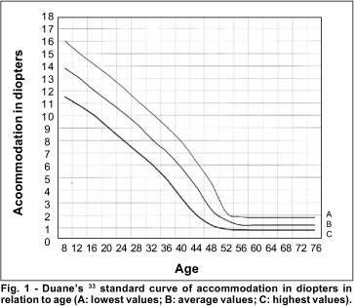
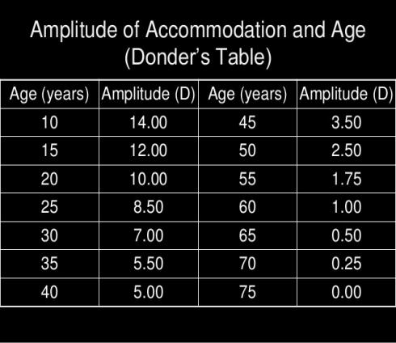
Amplitude of accommodation and age
The amplitude of accommodation declines throughout life until at about 50 or 60 years of age when it becomes zero

Slide 36
Amplitude of accommodation and age
Rule of 4’s
  Amplitude= 4x4-(Age/4)
  Example:
  Age of 20,
  Amplitude = 16-20/4
  = 11 diopters

Slide 37
Subjective measurement of AA: Weak points
Subjective measurements overestimate true
accommodative amplitude
Reasons why subjective measurement of accommodation should be avoided
# The endpoint of the subjective push-up test requires a
subjective evaluation of best image focus by the subject
and this endpoint varies between individuals

Slide 38
# Subjective evaluation influenced by depth of focus, visual
acuity, contrast sensitivity of the eye, and contrast of the
image
For example
- A dimly illuminated reading chart may provide a poor
stimulus to accommodate
- Different levels of illumination alter pupil diameter and
therefore depth of focus of the eye thus influencing the
near point of clear vision

Slide 39
# Measurements confounded by the increasing angular
subtense of the object
- As a reading chart is brought closer to the eye, this results
in an increased retinal image size and hence increased
legibility of the letters
# Inaccurate because of the lag of accommodation
- Accommodative response of the eye lags behind the
stimulus and that this lag increases as the stimulus
amplitude increases
Notes:
this can be avoided by carefully controlling the
image angular magnification with scaled letter sizes, this is
not done with the subjective push-up test.

Slide 40
Objective Methods of Measuring AA
Provide a true measure of accommodative amplitude of the eye
Can be done statically or dynamically
Autorefractors, refractometers or aberrometers are suitable instruments
Notes:
-Since accommodation results in a change in the optical
refractive power of the eye, accommodation can readily be
measured objectively

Slide 41
Provide a measure of the refraction of the eye as the eye
changes focus between a distant and a near target
The accommodative response amplitude is then determined as the difference between the refraction when looking at a distant target and the refraction when looking at a near target

Slide 42
Methods of Stimulating Accommodation
If a negative powered trial lens is placed in front of one eye
while viewing a distant letter chart, the consensual
accommodative response can be measured in the contralateral
eye
Also by muscarinic agonists (pilocarpine)
- The resulting accommodative response measured
periodically over 30–45 minutes using an autorefractor until the
maximal accommodative response is attained

Slide 43
The magnitude of the accommodative response depends on drug conc^{n}, intraocular pharmacokinetics, iris pigmentation and other non-accommodative factors that influence how much drug or how quickly the drug reaches the ciliary muscle
Notes:
Individuals with light irides showed a stronger accommodative response to pilocarpine than subjects with dark irides.

Slide 44
Accommodation facility
Aka inertia of accommodation
Tests the ease of accommodative response to the change in stimulus
Testing accommodative facility provides an index of how quickly accommodation can change

Slide 45
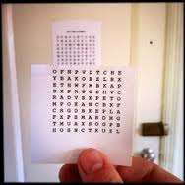
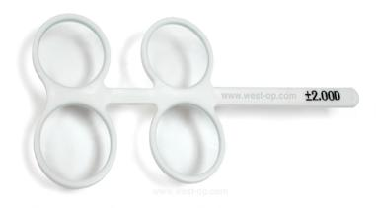
Accommodation facility
Measured in cycles per minute
Can be tested by two methods
Near – Far Test
Flipper Lens Test

Slide 46
Near-Far test
To determine flexibility of accommodative system
Rapidly alternates viewing distance
Done under monocular and binocular conditions
Not appropriate for moderate AA i.e. <4.50 DS
or absolute presbyopia

Slide 47
Procedure
Place a series of 20/25 to 20/30 high contrast letters on wall 6m away
Patient holds near VA chart at distance corresponding with no more than 2/3rd of patient’s AA
Appropriate distance correction worn

Slide 48
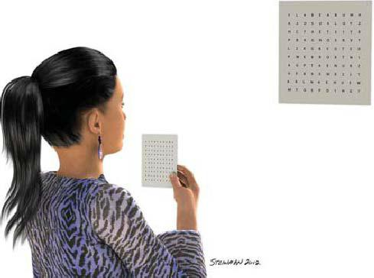
Procedure
Occlude patient’s left eye
Tell patient to switch focus
back and forth between letters on wall and near chart
after making letters clear
(This is done for 30 seconds)
Procedure repeated for left eye for 30 seconds

Slide 49
Record the number of cycles per minute
1 cycle = 2 jumps (jump from far to near and back to
far again)
Expected
Monocularly : 15 cycles per minute (minimum)
20 cycles per minute (average)
Binocularly : 12 cycles per minute(minimum)
16 cycles per minute (average)

Slide 50
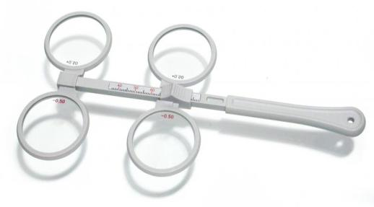
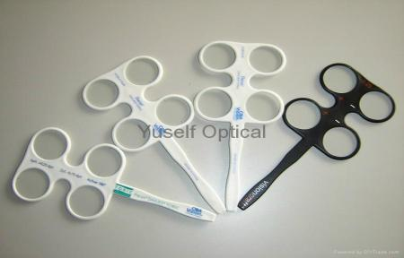
Flipper Lens Test
Flipper lens
- Two plus and two minus lenses mounted in same holder
- Available in powers of :
+/- 0.50, 1.00, 1.50, 2.00, 2.50, 3.00

Slide 51
Flipper Lens Test
Purpose
To determine the ability of accommodative system to
respond to lens created blur with a monocular stimulus
presentation
Note : In the binocular presentation, the ability of both
accommodative and vergence systems to interact is
tested

Slide 52

Procedure
Patient holds near-point VA chart with
20/25 letters at 40 cm
Direct light from overhead lamp
Distance correction worn
Left eye occluded
Flipper lens placed in front of right eye(usually minus side first)

Slide 53
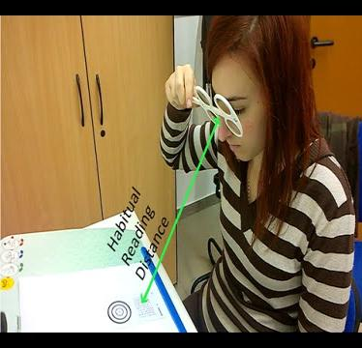
As soon as letters on acuity chart
becomes clear, it is flipped to other
side i.e. plus side
As letters become clear with plus
side flip back lens to minus
Continue the procedure for 30 seconds
The process repeated for left eye for 30 seconds

Slide 54
Record and interpretation
Record no. of cycles in a minute
1 cycle = plus to minus and back to plus again
Expected
Monocularly minimum = 12 cycles per min
average = 17 cycles per min
Binocularly minimum = 10 cycles per min
average = 13 cycles per min

Slide 55
Decreased accommodative facility
Accommodative Infacility
What does the patient complain of ?
“It becomes difficult to focus for near activities
after distance viewing and vice-versa”
Patient requires therapy with Hart Chart Rock near-distance method or with flipper lens

Slide 56
Fatigue of Accommodation
Aka ill-sustained accommodation
Measures ability of the eye to adequately sustain sufficient accommodation over an extended time period
Can be tested by RAF rule or flippers

Slide 57
With RAF rule, amplitude of accommodation is measured repeatedly
AA initially sustained with considerable effort, overtime it cannot be maintained
So, decrease of AA on repeated testing suggest
Fatigue of accommodation

Slide 58
Patient complains of
“letters become blurred after reading for sometime”
Treat patient with push up therapy or flipper lens therapy

Slide 59
Relative Accommodation
The amount of accommodation to be exerted under fixed convergence is called relative accommodation
Two types
Negative relative accommodation
Positive relative accommodation

Slide 60
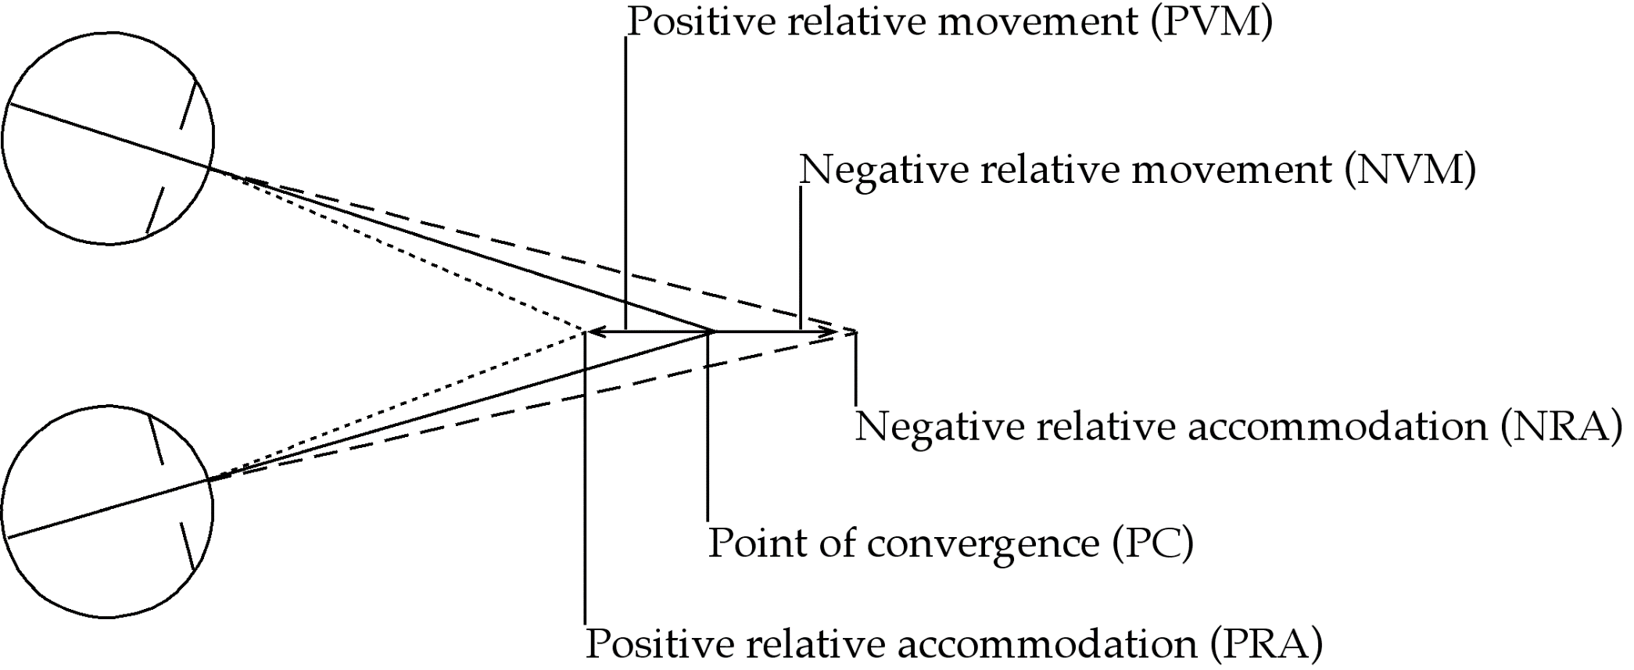
Fig: The relation between (PRA), (NRA), and (PC). The dotted
lines in the Figure describe the point the accommodation is focused to when a plus
lens (for NRA) or a minus lens (for PRA) is added without changing the
convergence stimuli. The positive relative movement (PRM) and negative relative
movement (NRM) describe the direction of the different dioptric focus change
movements of the PRA and the NRA in relation to the PC.

Slide 61
Negative Relative Accommodation
To test patient’s ability to decrease accommodation
while maintaining convergence at 40 cm
A reduced Snellen’s chart with 20/20 letters at 40 cm
Place patient’s distance correction in trial frame

Slide 62
Add plus power in 0.25 steps every 2 seconds until patient reports first blur
Normal values : +1.75 to +2.00 DS
Value of Negative Relative Accommodation

Slide 63
Positive Relative Accommodation
To test the patient’s ability to increase accommodation while maintaining convergence at 40 cm
Add minus power in 0.25 steps every 2 seconds until patient reports first blur
Normal values : -2.25 to -2.50 DS
Value of Positive Relative Accommodation

Slide 64
Lag of accommodation
Time lapse between the presentation of an accommodative stimulus and occurrence of the accommodative response
Average time
- Far to near accommodation is 0.64 seconds
- Near to far accommodation is 0.56 seconds

Slide 65
Accommodative response
- Measure of actual accommodation that is present
Accommodative stimulus
- Measure of accommodation exerted by target or stimuli
Lag of accommodation =
Accommodative stimulus – Accommodative response

Slide 66



Normal lag: +0.50 or +0.75D
High lag: +1.00D or higher
- Decreased lag: +0.25D or less
Assessed clinically by
Dynamic retinoscopy
Binocular cross cylinder test

Slide 67
Dynamic Retinoscopy
Objectively determines the point that is conjugate to the retina when the pt. is viewing a particular target
Goal is to determine accommodative Response
Also helps to determine the most appropriate near prescription with testing conditions

Slide 68
Techniques to perform dynamic retinoscopy include
Interposing additional lenses into line of sight to
achieve neutrality
Moving retinoscope in space to the point that is
conjugate to the retina

Slide 69
Methods of Dynamic Retinoscopy
Monocular Estimation Method (MEM)
Nott retinoscopy
Bell retinoscopy
Cross method
Sheard’s method
Tait’s method
Low neutral and high neutral method
Stress Point retinoscopy
Book (Getman) retinoscopy

Slide 70
Monocular Estimate Method (MEM) Retinoscopy
Gives an estimated measure of the spatial positioning of accommodation with regard to convergence
Cognitive demand is moderate
Done by interposing additional lenses in front of eyes

Slide 71
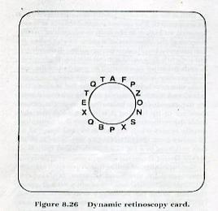
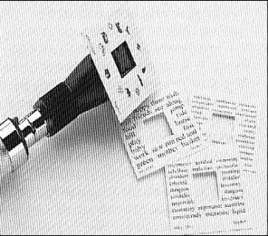
Materials
Series of cards with a central aperture mounted on a retinoscope
Cards can have printed letters, or words, or pictures that range in size from 20/160 to 20/30 arranged around the aperture

Slide 72
Procedure
Pt. instructed to keep the targets clear
Sweeps the retinoscope beam
Observe the motion of the retinoscopic reflex
Quickly interpose a trial lens at the spectacle plane (starting from +0.25 and increasing in 0.25 steps)

Slide 73
Interpretation
“lag of accommodation” is the amount of plus lens that neutralizes the reflex
Example
If the retinoscopic reflex is neutralized by +1.75D then lag
is +1.75
ADD = +1.75 – (+0.75)
= +1.00

Slide 74
Nott Dynamic Retinoscopy
Main purpose is identical to the MEM method
Cognitive demand is moderate
Done by moving retinoscope in space to the point that is conjugate to the retina

Slide 75
Materials
Reduced block of 20/20 (6/6) letters
- Placed at 16 inches (40 cm) from the patient

Slide 76
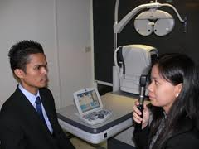
Procedure
Pt. wears the compensating distance lenses
Pt. directed to read the letters
Performs retinoscopy by moving farther from the plane of regard until the motion is neutralized

Slide 77
Interpretation
Dioptric difference between these two distances equals the lag of accommodation
Example
Distance from the target to spectacle plane = 40cm
Distance from retinoscope to spectacle plane = 50cm
Lag of accommodation = +2.50D – 2.00D
= +0.50D

Slide 78
Bell Retinoscopy
Evaluate the performance of the accommodative system under moving & real life conditions in free space
Cognitive demand is low

Slide 79
Materials
Three dimensional viewing target
A small, highly reflective bell dangling from String
- replaced with a Wolff Wand (½ inch diameter, metal
ball mounted on the end of a rod)

Slide 80
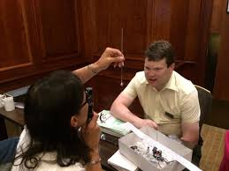
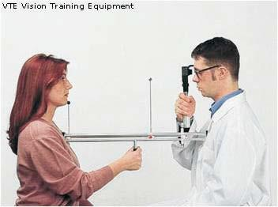
Procedure
Wand is held by the examiner
Moved closer to and farther from the patient - slower than 2 inches/sec

Slide 81
Procedure
Retinoscope is positioned at a fixed distance of 50 cm (20 inches)
Patient fixates the target and the examiner notes the direction of the reflex

Slide 82
Procedure
Target is moved closer to the patient there will be a point where the motion changes from “with” to “against’’
Target is again moved away from patient until with motion is observed

Slide 83
Interpretation
Distance between the retinoscope and the target, when the motion change occurs, is a physical measure of the lag of accommodation

Slide 84
“with” to “against” motion is observed at 35 – 42 cm (14 - 17 inches)
“against” to “with” at 37 - 45 cm. (15 -18inches)
Accommodative flexibility can be assessed by observing how quickly or sluggishly the reflex changes

Slide 85
Binocular Cross Cylinder Test
Method of determining lag of accommodation
Blur no longer provides a stimulus for accommodation but disparity vergence is fully functional

Slide 86
Procedure
Use the cross grid on the near point card
With patient’s distance correction in trial frame, place cross cylinder with minus cylinder axis vertical (090 degree) in front of eye
Ask patient “Are ‘up and down’ or
‘across’ lines clearer, blacker,
or sharper ?”
Notes:
Use of the words vertical and horizontal can cause confusion

Slide 87
If ‘across’ (horizontal) lines clearer
- Under accommodation
- So, add plus power binocularly until patient reports
equality or vertical lines become clearer
If ‘up and down’ (vertical) lines clearer
- Over accommodation
- So, add minus power binocularly until patient reports
equality
Notes:
If the pt. accommodates exactly for the target position, the two sets of lines should be equally clear, since the image of the horizontal lines is 0.05 D in front of the retina and the vertical lines will lie 0.05D behind the retina

Slide 88
High lag >+0.75D
Inadequate accommodative response
As a result of :- Near esophoria
Poor negative vergence
Accommodative insufficiency
Uncorrected hyperopia
Patient is over minused

Slide 89
Lead of Accommodation < +0.25D
Over accommodating
As a result of :- Near exophoria
Spasm of accommodation
Over plus correction
Inadequate positive vergence

Slide 90
References
Clinical Procedures in Optometry by J.D. Bartlett, J.B. Eskridge, J.F. Amos
Theory and Practice of Squint and Orthoptics by A.K.Khurana
Adler’s Physiology of the Eye by L.A. Levin, S.F. Nilsson
Borish’s Clinical Refraction by W.J. Benjamin
Internet

Slide 91
Thank You
For Other PPTs and Eye Health Articles, visit us at healthkura.com

