Slide 1
ANTI GLAUCOMA DRUGS
Bikash Sapkota
Optometrist
Maharajgunj Medical Campus, Nepal
www.healthkura.com
Only for offline informational uses. Copyright © Bikash Sapkota

Slide 2
Presentation Layout
Introduction to glaucoma
Anti glaucoma drugs:
Classification
Indications
Contraindications
Summary

Slide 3
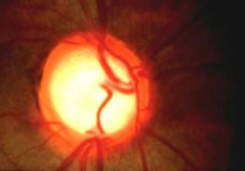
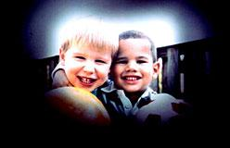
Introduction
Glaucoma refers to a group of diseases characterized by
Optic neuropathy
Specific pattern of visual field defect
Raised IOP
VISUAL FIELD LOSS
OPTIC NERVE DAMAGE
GLAUCOMA
INCREASE
IOP
Notes:
Damage to optic nerve is irreversible process
Normal IOP is 10-21mmHg

Slide 4
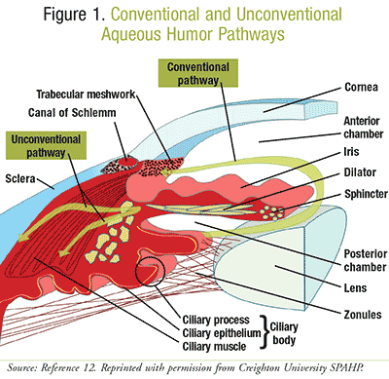
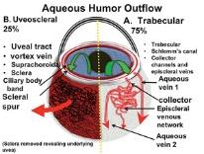
Aqueous production and drainage
Secretion of aqueous humour
-ciliary body (posterior chamber)
Route of drainage
-primary (90%) : trabecular meshwork
-uveo-scleral outflow(10%)

Slide 5
Purpose of initiating glaucoma therapy
The ultimate goal of glaucoma treatment is
To preserve enough vision during the patient’s
lifetime to meet their functional needs
Ideally, treatment should also delay glaucomatous
process

Slide 6
MEDICAL ASPECTS OF GLAUCOMA THERAPY
When to treat ?
- when glaucomatous damage is documented or future
damage is likely
What to prescribed ?
- best to try one drug with least ocular & systemic side
effects
- use least amount of medication
- in emergency use 2 drugs

Slide 7
Mechanisms of action of anti glaucoma agents
Chief therapeutic measure is to lower IOP to the target level either by
Reducing aqueous production in the ciliary body
Promoting aqueous humour outflow through the
trabecular meshwork
Promoting aqueous humour outflow via the uveoscleral
pathway

Slide 8
Classification of anti glaucoma drugs
Topical Drops
Beta blockers
e.g. timolol, carteolol, betaxolol,levobunolol and metipranolol
Adrenergic agonists
e.g. epinephrine, dipivefrin, brimonidine and apraclonidine
Prostaglandin analogue
e.g. latanoprost, bimatoprost ,unoprostone
Cholinergic agents
e.g. pilocarpine, carbachol,demecarium bromide and echothiophate iodide
Carbonic anhydrase inhibitors
e.g. dorzolamide and brinzolamide

Slide 9
Systemic Drops
Carbonic anhydrase inhibitors
e.g. acetazolamide and methazolamide
Osmotic agents
e.g. glycerine, mannitol and urea

Slide 10
Beta blockers
First drug of choice for POAG
Lower IOP by reducing aqueous secretion due to their effect on β₂ receptors
Non selective β₁ & β₂
Timolol
Levobunolol
Metipranolol
Carteolol
Selective β₁ blockers
Betaxolol
Pindolol
Metaprolol
Notes:
Beta 2 is present in ciliary epithelium

Slide 11
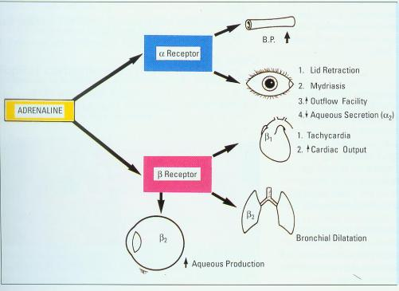
Mechanism of action
Reduction in aqueous secretion
Antagonize the effect of catecholamines
Topical β-blockers reduce aqueous formation by 24% to 48% in
awake humans
β-blockers are ineffective during sleep
Notes:
Alpha 1 receptor are located in arteriole, dilator muscle, muller muscle.stimulation will result in hypertension, dilatation, lid retraction.
Alpha 2 are located in ciliary epithelium. Its stimluation will cause decrease aqueous production
Beta 1- is present in myocardium . Result in tachycardia and increase cardiac output
Beta 2 is present in bronchi and ciliary epithelium. Stimulation causes bronchodilatation, and increase aqueous production.

Slide 12
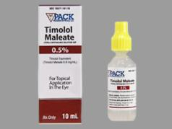
Beta blockers
Timolol
Most commonly used agent
Non-selective β blocker
As a salts of : maleate, Hemihydrate
  Concentration: 0.25% & 0.5%,
  1-2 times daily
Efficacy
IOP decrease : 20% to28%
Peak – 2-3 hrs
Washout : 1 month
Notes:
If one time daily use is chosen,its better to use drop in the morning
Both timolol and betaxolol accumulate in Tenon’s capsule where a reservoir effect
may occur allowing gradual release of these agents long after they
have been discontinued
Not useful in patient already on systemic beta blockers bcoz most of the beta receptors are already blocked

Slide 13
Beta blockers
Short term escape:
  Marked initial fall in IOP followed by transient rise with moderate fall in IOP
Long term drift:
  Slow rise in IOP in patients who were well controlled with many months of therapy
Notes:
Short term escape :is due to an increase in the number of β-adrenergic receptors
in the ciliary processes under the condition of prolonged
β-adrenergic blockade
Long term drift : a time-dependent decrease
in cellular sensitivity to adrenergic antagonists..tachyphylaxis.

Slide 14
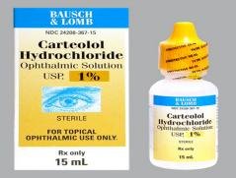
Beta blockers
Carteolol
Non selective beta blocker
As effective as timolol
Intrinsic sympathomimetic activity and ability to partially
activate β-receptors in the absence of catecholamines
Advantages
Less stinging
Best choice in pt. with POAG having associated hyperlipidemias
or atherosclerotic cardiovascular disease
Concentration : 1% drop,
1-2 times daily
Notes:
They are partial antagonist
It has less effect on serum lipid level than timolol

Slide 15
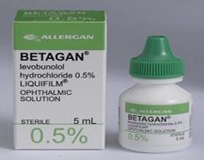
Beta blockers
Concentration : 0.25 – 0.50% drop,
once daily
Levobunolol
Reduces IOP by
Reducing aqueous humor formation
Advantage
Action lasts the longest, so is more reliable for once a day use than timolol
Contraindications
Pts. predisposed to cardiac or respiratory disease

Slide 16
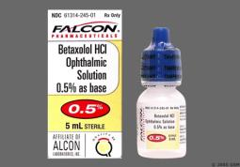
Beta blockers
Concentration : 0.25% drop,
2 times daily
Betaxolol
First selective β₁ blocker used
in ophthalmology
Long term effect is slightly less than Timolol and Levobunolol
Advantage
Initial therapy in pts. with asthma and other pulmonary problems

Slide 17
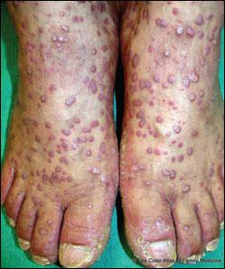
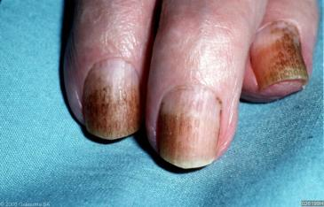
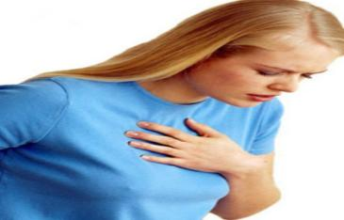
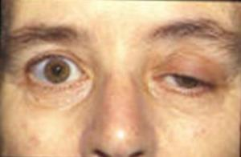
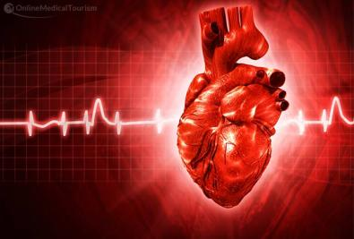


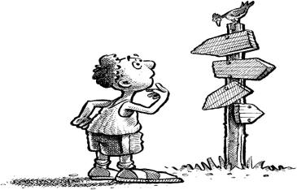

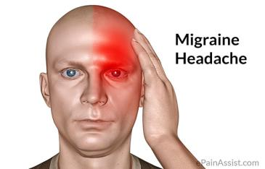

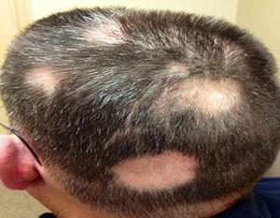
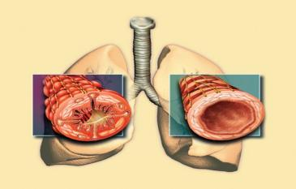
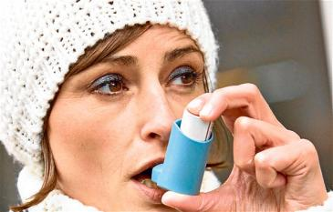
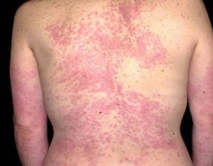

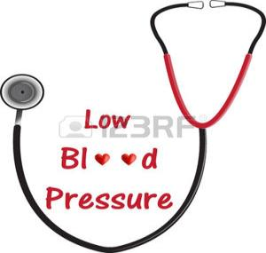



Adverse effects of β-blockers
Central nervous system
Amnesia
Depression
Confusion
Headache
Impotence
Insomnia
Migraine prophylaxis
Myasthenia gravis
Gastrointestinal
Diarrhea
Nausea
Pulmonary
-Bronchoconstriction/
bronchospasm
-Asthma
-Dyspnea
Cardiovascular
-Bradycardia
-Conduction arrhythmias
-Hypotension
-Raynaud’s phenomenon
-Fluid retention
Dermatologic
Alopecia
Nail pigmentation
Urticaria
Lichen planus
Notes:
Amnesia:Partial or total loss of memory
Bradycardia:Abnormally slow heartbeat
Arrhythmias :An abnormal rate of muscle contractions in the heart
Dyspnea:Difficult or labored respiration
Alopecia:Loss of hair (especially on the head)
Lichen planus: ithchy allergic reaction affecting limbs

Slide 18
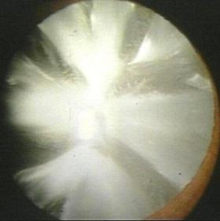
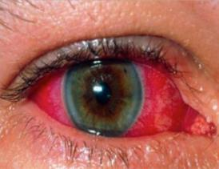
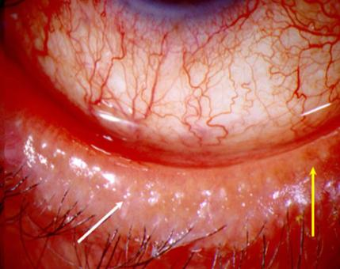
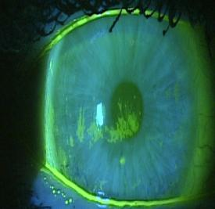
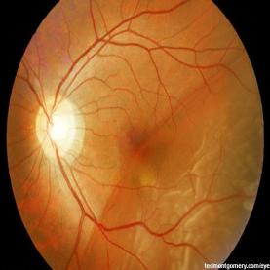
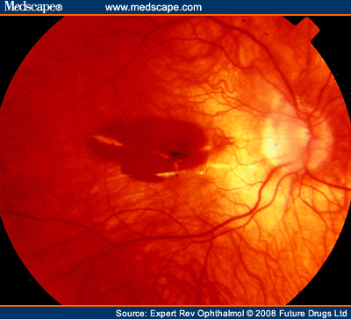
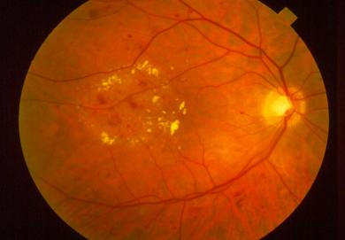
Beta blockers
Allergic blepharoconjunctivitis
Dry eye/decreased tear breakup time
Corneal anesthesia
Macular edema (aphakics)
Macular hemorrhage/retinal detachment
Uveitis
Cataract progression
Allergic blepharoconjunctivitis
Dry eye/decreased tear breakup time
Corneal anesthesia
Macular edema (aphakics)
Macular hemorrhage/retinal detachment
Uveitis
Cataract progression
Ocular side effects

Slide 19
Beta blockers
Indications
Open angle Glaucoma
Angle closure Glaucoma
Secondary Glaucoma
Glaucoma in children

Slide 20

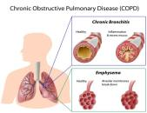
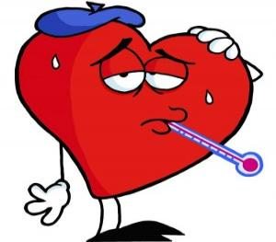
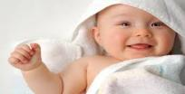

Beta blockers
Contraindications
Bronchial asthma
History of bronchial asthma
Severe COPD
Bradycardia
Severe heart block
Overt cardiac failure
Children & infants

Slide 21
Beta blockers
Selection of β-Blockers
Clinical issues | Preferred drug
Best IOP control | Avoid Betaxolol
Cost | Generic Timolol
 | Metipranolol
 | Timolol hemihydrate
Comfort | Carteolol
Hypercholesterolemia | Carteolol
COPD | Betaxolol
Pregnancy | Avoid all

Slide 22
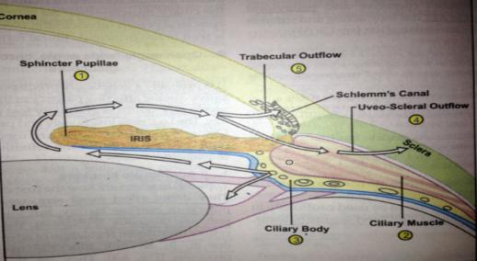
Adrenergic agonist
Mode of action
Decreasing aqueous formation by constricting the
ciliary blood vessels
Increasing uveoscleral outflow by an increase in
prostaglandin synthesis

Slide 23
Adrenergic agonist
α₂ selective
Apraclonidine
Brimonidine
α and β agonist
Epinephrine
Dipivefrin
Phenylephrine
Notes:
Alpha 1 vasoconstriction of ciliary vessles decreased acqueous formation
Alpha 2 ciliary epithelium : decreased secretory activity

Slide 24
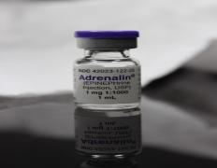
Adrenergic agonist
Concentration : 0.5-2% drop,
2 times daily
Epinephrine
Nonselective α- and β-adrenergic agonist
Onset of action occurs at 1 hr
Peak effect at 4 hours
Ocular hypotensive effect may last up to 72
hours
IOP control : 20 -25 %

Slide 25

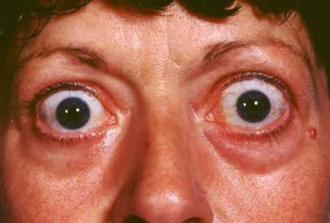
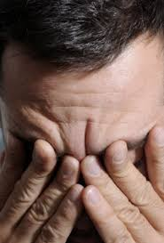
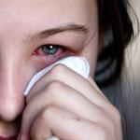
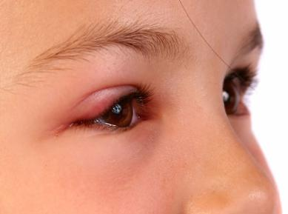
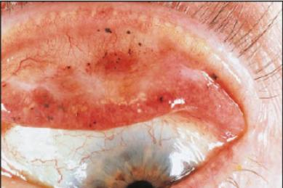
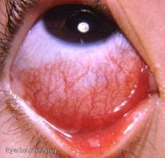
Adrenergic agonist
Side effects of epinephrine
Stinging
Browache
Conjunctival hyperemia
Adenochrome deposits
Allergic lid reactions
Macular edema
Blepharoconjuntivitis
Systemic hypertension
Arrythmia
Contraindications
Severe Hypertension
Cardiac Diseases
Thyrotoxicosis
Notes:
Instilled epinephrine undergoes oxidation and polymerization
to form adrenochrome, a pigment of the melanin family.
Adrenochrome deposits are often found in the lower conjunctival
cul-de-sac, where they may be mistaken for foreign
bodies
These deposits generally produce no symptoms
Adrenochrome deposits in the conjunctiva may last
for years even after discontinuation of the drug

Slide 26
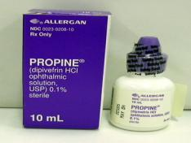
Adrenergic agonist
Concentration : 0.1% drop,
2 times daily
Dipivefrin
Prodrug
Penetration across the cornea is 17 times more than epinephrine
Better tolerated than epinephrine
Onset of action : 30 minutes, Peak effect : 1hr
IOP reduction :20-24%
Advantage
Lower cardiovascular side effects
Can be used in pts. of asthma, in young pts. intolerant to
miotics and in those with cataracts
Notes:
undergoes biotransformation to epinephrine within the cornea by esterase enzyme
Greater penetration due to lipophilic nature
Differs from epi in that it lacks benzene group
Often combined with echthiophate to reduce iris epithelial cys t

Slide 27
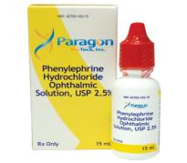
Adrenergic agonist
Phenylephrine
Acts on α₁ adrenergic receptors
MOA : Induce vasoconstriction and mydriasis to break posterior
synechiae
Can produce mydriasis even in pts. treated with strong
miotics
Concentration : 0.125-10 %drop

Slide 28
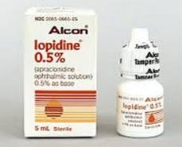
Adrenergic agonist
Apraclonidine
α₂-adrenergic agonist
Para amino derivative of clonidine
IOP control : 20 % -30 %
Maximal effect is produced 3-5 hours after dosing
Concentration : 1% and 0.5%,
twice daily
Not used as primary treatment due to significant tachyphylaxis
Mainly indicated in acute pressure spikes in case of laser iridotomy, trabeculoplasty, and posterior capsulotomy
Notes:
This para amino derivative decrease penetration to blood brain barrier and thus reduces the risk of systemic hypertension and reduces CNS side effects
1.0% concentration is used to control postsurgical
elevations in IOP after anterior segment laser
surgery and for short-term IOP control in open-angle
glaucoma before filtering procedures

Slide 29
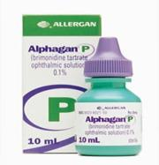
Adrenergic agonist
Brimonidine
Small effect on uveoscleral
outflow
Neuroprotection
IOP control: 20-30%
Advantage
Can be used as primary drug in POAG
Less tachyphylaxis & less rate of allergic
reactions than apraclonidine
Concentration :tartrate 0.2%,
tartrate in purite 0.1%BD, TID
Notes:
It is the drug of choice in chronic treatment of glaucoma and in patients with cardiopulmonary disease and who have contraindications to b-blocker
Neuroprotection:it promotes ganglion cell survival after ischaemic damage or elevated glutamate level

Slide 30
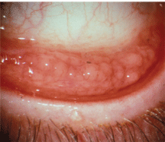

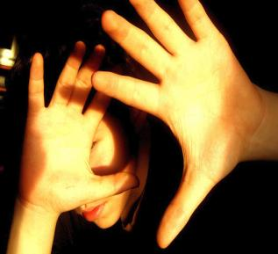


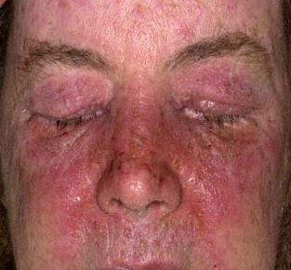
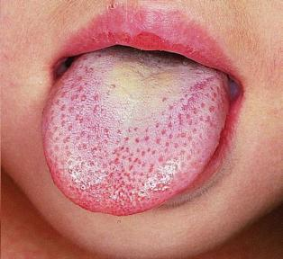
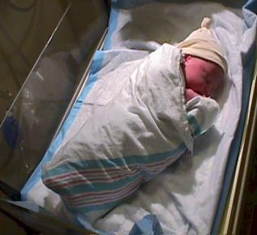
Adrenergic agonist
Side effects
Systemic
Dry mouth
Fatigue
Drowsiness
Headache
Hypotension
Bradycardia in neonates
Hypothermia in neonates
Ocular
Allergy
Contact dermatitis
Blurred vision
Burning/ stinging
Follicular conjunctivitis
Hyperemia/itching
Photophobia
Notes:
Brimonidine alters matrix mellanopreotease in the corneal cells and thus they may contribute to ocular surface disease

Slide 31
Cholinergic drugs
Contraction of the iris sphincter: Constricts the pupil (miosis)
Mechanism of action
contraction of the longitudinal fibers of the ciliary
muscle, producing tension on the scleral spur: (Opening the trabecular meshwork) and facilitating aqueous outflow
Contraction of the circular fibers of the ciliary muscle, relaxing the zonular tension on the
lens equator : Accommodation

Slide 32
Classification of Cholinergic Agonists
Direct-acting
Acetylcholine
Methacholine
Pilocarpine ▪ drop- 0.5, 1, 2, 4, 6 %,gel-4%
Carbachol ▪ drop-1.5, 3%
Indirect-acting (cholinesterase inhibitors)
Reversible
Physostigmine
Neostigmine
Edrophonium
Demecarium
Irreversible
Echothiophate ▪ drop-0.125%
Diisopropylfluorophosphate
▪ Formulated for topical ocular use
Activate cholinergic receptors directly at the neuroeffector junctions of the iris sphincter muscle and ciliary body
Exert their cholinergic effects primarily by inhibiting
cholinesterase, thereby making increased amounts
of acetylcholine available at cholinergic receptors

Slide 33
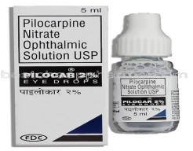
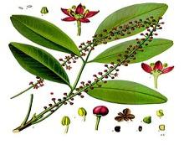


Cholinergic drugs
Pilocarpine
Derived from the plant Pilocarpus
Microphyllus
IOP decrease : 15-25%
Peak : 1 ½ - 2hrs
Effect lasts up to : 6-8 hrs
Gel form at bedtime
Concentration : 0.25- 10% drop QID, 4% gel, ocusert:20-40µg/hr
Notes:
Ocusert:thin elliptical micro units containing drug in reservoir
Placed under lower eyelid
Delivers drug for 7 days

Slide 34
Cholinergic drugs
Ocular pigmentation influences
Blue eyes show maximal ocular hypotensive responses
Darkly pigmented eyes demonstrate a relative resistance to IOP reduction
may require pilocarpine solutions in concentrations exceeding 4%

Slide 35


Cholinergic drugs
Indications
Acute and chronic narrow angle glaucoma
Open angle glaucoma
For prophylaxis of primary angle-closure glaucoma until a
peripheral iridotomy can be performed
Notes:
During an acute
angle-closure attack, the IOP is often in excess of 60 mm
Hg.At those high pressures the ischemic iris sphincter is
unresponsive to pilocarpine. Topical β-blockers, apraclonidine,
or systemic agents are indicated initially to
bring the pressure below 50 mm Hg before pilocarpine is
administered.

Slide 36
















Ocular Side Effects
Accommodative spasm
Miosis
Follicular conjunctivitis
Pupillary block with secondary angle-closure glaucoma
Band keratopathy
Allergic blepharoconjunctivitis
Retinal detachment
Conjunctival injection
Lid myokymia
Anterior subcapsular cataract
Iris cyst formation
Systemic Side Effects
Headache
Browache
Marked salivation
Profuse perspiration
Nausea
Vomiting
Bronchospasm
Pulmonary edema
Systemic hypotension
Bradycardia
Generalized muscular weakness
Abdominal pain, diarrhea

Slide 37
Cholinergic drugs
Contraindications
Presence of cataract
Patients younger than 40 years of age
Neovascular and uveitic glaucoma
History of retinal detachment
Asthma or history of asthma
High myopia
Known hypersensitivity to the drug

Slide 38

Cholinergic drugs
Carbachol
Concentration : 0.75-3%,
TID
It is a dual acting parasympathomimetic
Direct action- by stimulation of end plate potential
Indirect action- by inhibition of acetylcholine esterase
Ocular pain, impaired vision due to induced
accommodation & myopia
1% for intracameral use during surgery
Side effects
Acetylcholine

Slide 39
Cholinergic drugs
Physostigmine
Concentration : 0.25-0.5% drop
It is an indirect acting parasympathomimetic
Constriction of sphincter pupillae muscle around
the pupillary margin and thus increases aqueous outflow
Retinal detachment, miosis, cataract, pupillary
block glaucoma, iris cyst, browache and punctal stenosis
Mechanism
Side effects

Slide 40
Prostaglandin Analogue
Originally discovered in the eye as mediators of the ocular
inflammatory response
Pro-drugs
Converted to active compound by corneal esterases
MOA: Increases uveoscleral outflow
PG stimulates collagenase and metalloproteinase to degrade the
extracellular matrix between ciliary muscle bundles, which in
turn leads to the reduction of hydraulic resistance to uveoscleral
flow

Slide 41

Prostaglandin analogue
Latanoprost (Xalatan)
Lowers IOP 27-30% with peak at 10-14 hrs
Maximum effect usually by 4-6 weeks, may have further
decrease after 3-4 months
Latanoprost tends to be less effective in lowering IOP in
children than in adults
Concentration : 0.005% drop,
Once daily

Slide 42

Prostaglandin analogue
Travoprost (Travatan)
Lowers IOP 7-9 mmHg (27-33%)
Maximum IOP lowering effect achieved within 2
weeks
Concentration : 0.004% drop,
once daily in evening
.

Slide 43

Prostaglandin analogue
Bimatoprost (Lumigan)
Prostamide analog
Better IOP control than Latanoprost
Maximum IOP effect within 1-2 weeks
Concentration : 0.03% drop,
Once in the evening
.
Notes:
It means bimatoprost differs sufficiently in both structure
and function from other prostaglandin compounds to
warrant a new class of ocular hypotensive agents, called
prostamides

Slide 44
Prostaglandin analogue
Indications
Contraindications
Primary open angle glaucoma
Normal tension glaucoma
Chronic closed angle glaucoma
Pigment dispersion syndrome
Exfoliation glaucoma
Allergy
Pregnant and nursing mother
Children
Uveitic glaucoma
Immediate postoperative period
Pt. with healed or active herpes simplex keratitis
Notes:
In children it is less effective

Slide 45











Ocular side effects
Systemic side effects
Cornea: punctate erosions, corneal pseudodendrites, recurrent herpes keratitis
Conjunctiva : hyperemia
Eyelash : lengthening, thickening,
hyperpigmentation
Iris : irreversible
hyperpigmentation
periorbital skin :
hyperpigmentation
CME after cataract surgery
Allergy
Anterior uveitis
Occasional headache
Skin rash
URTI
Notes:
No systemic side effect because of low concentration of drug and short plasma half life
Increase in iris pigmentation :It usually occurs after 6 months, may persist for 2 years after discontinuation of treatment.:Mechanism is PG may stimulate synthesis of melanin within iris melanocyte but not an increase in melanocyte no.

Slide 46
Advantage
Prostaglandin analogue
Once daily dosing
Lack of cardiopulmonary side effects
Additivity to other anti glaucoma medications

Slide 47
Carbonic anhydrase inhibitor
Mechanism of action
Mechanism
Inhibit enzyme carbonic anhydrase
Reducing aqueous humour formation
Lower IOP
    99% inhibition of CA – decrease aqueous production
Notes:
(nonpigmented epithelium of ciliary processes)-60% of the aqueous humour formation is dependent on this enzyme.
cA is essential to form bicarbonate….bicarbonate formation is essential for aq. Production
Most tissues contain carbonic anhydrase in quantities
that exceed physiologic requirements. Because of this
excess, at least 99% of carbonic anhydrase activity must be
inhibited to depress aqueous production significantly

Slide 48
Carbonic anhydrase inhibitor
Systemic
Acetazolamide
Methazolamide
Ethoxzolamide
Dichlorphenamide
Topical
Dorzolamide
Brinzolamide
Lodoxamide

Slide 49


Carbonic anhydrase inhibitor
Acetazolamide
Oral/IV preparation
IOP decrease : 15-20%
Peak : 2-4 hrs (oral), 30 mins (IV)
Washout : 12 hrs (oral ),4 hrs (IV)
Concentration
Oral : 125mg & 250mg tablet- 6 hrly
500mg sustained-release capsules -2 times
For children(5-10mg/kg)-6 to 8 hrly
IV preparation- 500mg
Notes:
Acetazolamide has poor lipid solubility and corneal penetration, so not applied topically
Carbonic anhydrase is present in the corneal endothelium so drugs that affect it impair its pump mechanism.thus contraindicated in pt. with compromised endothelium and who have gone keratoplasty.
In contrast to
timolol, which has no significant effect on aqueous flow
in sleeping humans, acetazolamide reduces aqueous flow
during sleep. In humans, the aqueous flow rate normally
decreases approximately 60% during sleep.Acetazolamide
suppresses aqueous flow an additional 24% below the
nocturnal flow rate.

Slide 50






Side Effects of Acetazolamide
Ocular
Transient myopia
Systemic
Numbness and tingling of extremities and perioral region
Metallic taste
Symptom complex
Decreased libido
Depression
Fatigue
Malaise
Weight loss
Gastrointestinal irritation
Metabolic acidosis
Hypokalemia
Renal calculi
Blood dyscrasias
Dermatitis

Slide 51
Carbonic anhydrase inhibitor
Contraindications to Acetazolamide
Clinically significant liver disease
Severe chronic obstructive pulmonary disease
Certain secondary glaucoma
Renal disease, including kidney stones
Pregnancy
Known hypersensitivity to sulfonamides

Slide 52

Carbonic anhydrase inhibitor
Methazolamide
Potency > acetazolamide
Improved intraocular penetration
Higher water and lipid solubilities
Increased half life and plasma conc^{n}
Can be given at lower doses than acetazolamide
Dose : 25-50mg x BD/TDS
Indication : chronic IOP reduction

Slide 53


Carbonic anhydrase inhibitor
Topical
Dorzolamide 2% & Brinzolamide 1%
Efficacy
IOP decrease : 15-20%
peak : 2-3 hrs
washout : 10-18 hrs
Dose : 2-3 times daily

Slide 54
Carbonic anhydrase inhibitor
Ocular side effects
Induced myopia
Stinging sensation
Keratitis, conjunctivitis
Dermatitis
Systemic side effects
Similar to oral CAI but less likely
Contrainidications
Pt with known hypersensitivity to sulfonamide

Slide 55
Hyperosmotic agents
IV : Mannitol , urea
Oral : glycerol, isosorbide
Mechanism of action
Increase blood osmolality
Osmotic gradient between blood and vitreous
Water is drawn out of vitreous
Notes:
Osmotic agents are approved for the short -term
management of acute glaucoma in adults and may be used in the reduction of vitreous
volume prior to cataract surgery.

Slide 56

Hyperosmotic agents
IV Preparation
Mannitol
    20% solution 1-2gm/kg or
    5(2.5-7)ml/kg over 20 min
    Onset:15-30min
    Peak:30-60min
    Last : 6hrs
Notes:
Mannitol must be given intravenously because it is not absorbed from the
gastrointestinal tract.

Slide 57


Hyperosmotic agents
Oral Preparation
Glycerol
    50% solution ,1gm/kg or 1.5-3 ml/kg
    Onset: 20min
    Peak:45mins -2 hrs
    Duration:4-5hrs
    caution in Diabetics
Isosorbide
    45% solution
    1.5-4 ml/kg

Slide 58
Hyperosmotic agents
Side effects
Gastrointestinal system
    Nausea,vomiting,abdominal cramp
Cardiovascular system
    CHF,angina
CNS
    Subdural hematoma, Headache, confusion, disorientation,fever
Renal
    Diuresis, anuria, potassium loss
Others
    Diabetic ketoacidosis ,urticaria.
Notes:
Hematoma:A localized swelling filled with blood
Angina:A heart condition marked by chest pain due to reduced oxygen to the heart
Diuresis:Increased secretion of urine
Anuria:Inability to urinate
Ketoacidosis:Acidosis with an accumulation of ketone bodies; occurs primarily in diabetes mellitus

Slide 59
Summary
Open angle glaucoma
1.β-blockers :Timolol, Betoxolol, Levubunolol
2.Miotic : Pilocarpine
3.α adrenergic agonist : Adrenaline, Dipiverdine, Brimonidine
4.Carbonic anhydrase inhibitors : Acetazolamide, Dorzolamide
5.Prostaglandin : Latanoprost

Slide 60
Summary
Angle closure glaucoma
Combination of vigorous therapy is employed
1.Beta blocker –Timolol eye drop
2.Miotic – Pilocarpine eye drop every 10 min
3.Hypertonic- mannitol injection (20%)
4.Acetazolamide orally
5.Apraclonidine eye drop

Slide 61
Mode of action of anti glaucoma drugs
Summary
Beta blocker-decrease aqueous secretion
Miotics -increase trabecular outflow
Adrenergic agonist-decrease aqueous secretion
Prostaglandin-increase trabecular and uveaoscleral outflow
Carbonic anhydrase inhibitor-decrease aqueous secretion

Slide 62






References
Clinical Ocular Pharmacology by Jimmy D Balett
Ophthalmic Drugs by Graham Hopkins & Richard Pearson
Comprehensive Ophthalmology by A.K. Khurana
AAO-Section 10-Glaucoma
AAO-Section 2-Fundamentals & Principles of Ophthalmology
Internet

Slide 63

For more PPTs and Articles visit https://healthkura.com/

